Slide 1
Eastern Mosquitofish (Gambusia holbrooki)
- Short-lived live-bearer, trying to maximize reproduction before water disappears
- Aggressive; rapid colonizer; very harmful exotic species all over the world
Not to be confused with:
Sailfin Mollies, which are more diamond shaped and tend to have more prominently outlined scales
Bluefin Killifish, which have a very prominent lateral stripe
Least Killifish, which are very tiny and have vertical stripes and sometimes a lateral stripe
Eggspot – Found only on female mosquitofish
Gonopodium – Sexual organ of male

Slide 2
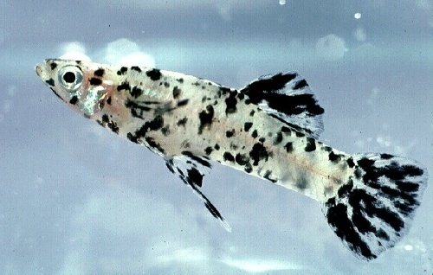
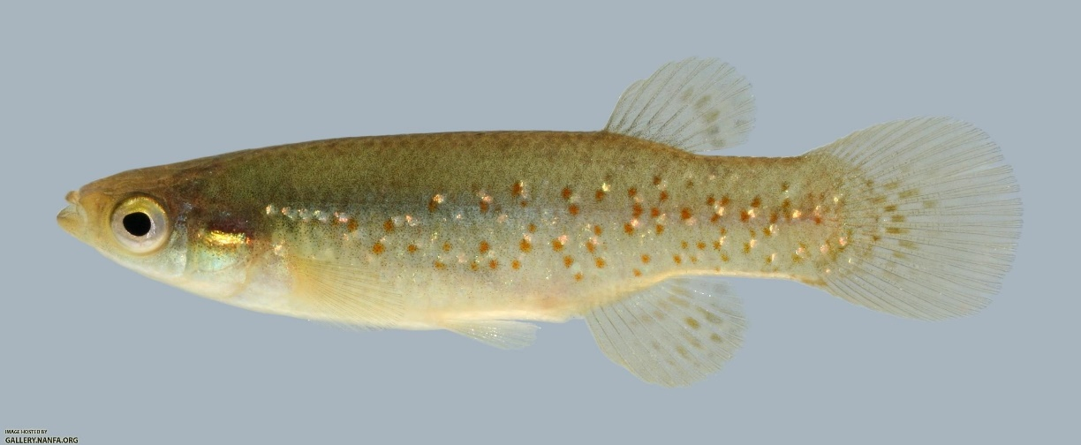
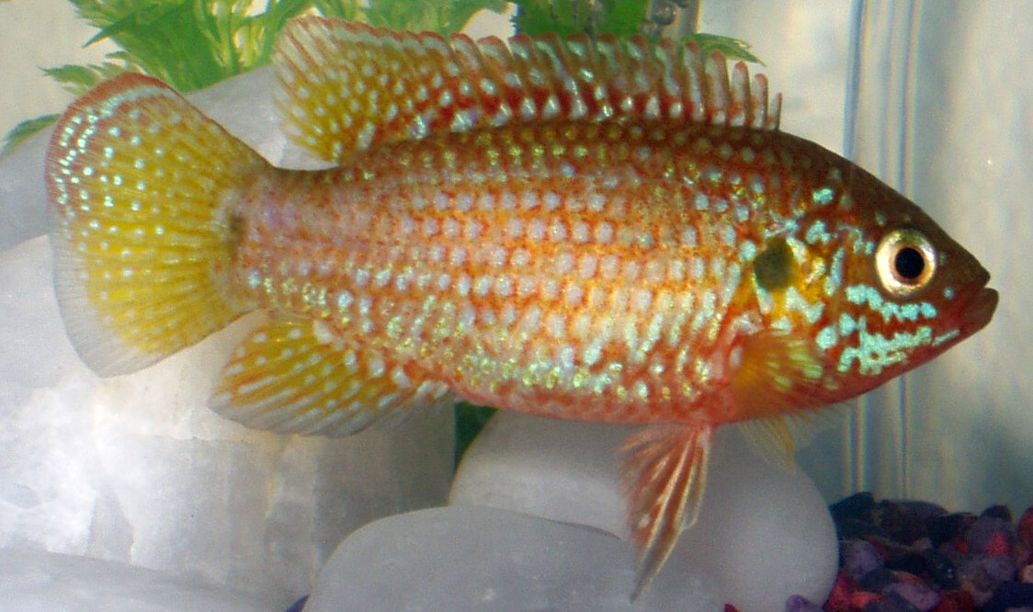
Melanistic eastern mosquitofish (Gambusia holbrooki)
-They have a cool color pattern as a result of a genetic mutation.
Golden topminnow (Fundulus chrysotus)
African Jewelfish (Hemichromis letourneuxi)
-invasive species

Slide 3
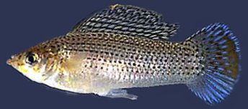
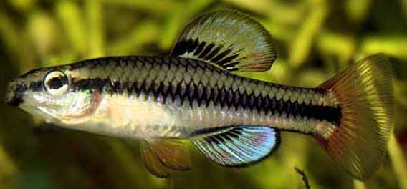
Least killifish (Heterandria formosa)
- Until recently, thought to be the smallest vertebrate in the world
- Most abundant fish in the Everglades, also a livebearer
Sailfin Molly (Poecilia latipinna)
- Another common Everglades livebearer
Bluefin Killifish (Lucania goodei)
- Males have very bright red and blue fins
- One of the dominant species in the Everglades in wet years, but take years to recover from bad droughts

Slide 4
Juvenile sunfish (Lepomis spp.)
- Could be one of several species
- Sunfish have evolved to take advantage of many niche spaces in North America’s freshwaters
- Most species are awesome parents. The males will build a pit and will very aggressively defend the brood for several weeks after they hatch.
Juvenile cichlids (Family Cichlidae)
- Could be one of several species
- Widely introduced throughout Florida and elsewhere in the world; species could be from Central or South America as well as Africa.
- Also awesome parents; usually mobile with both parents watching over the brood

